Slide 1
This keynote will take you through:
1. Work done as a chassis structure engineer at Team Manipal Racing
2. Key learnings

Slide 2
Work done in TMR
Design and development of an mBAJA chassis for off-road racing
Material selection
CAD design using SolidWorks
CAE analysis using Hyperworks, Ansys
DFMEA
Factor of Safety – 1.3
Manufacturing of the chassis & body panels
Assembly of the vehicle
Stress-testing and validation
Training new talent

Slide 3
Information about the next page…
The next page is the summary of my work in DFMEA.
It is the actual analysis that was submitted to SAE during the competitions

Slide 4

DFMEA
DESIGN FAILURE MODES AND EFFECT ANALYSIS
11
Component | Failure Mode | Failure Cause | Failure Effect | S | O | D | RPN | Recommended Action | S | O | D | RPN
Frame | Bending & breaking of Frame | High Impact load | Driver safety compromised, | 10 | 4 | 7 | 280 | Accurate simulation & extensive testing | 10 | 3 | 6 | 180
Uprights | Structural failure, cracks & bending | Axial loads along with impact loads & fatigue | Loss of drive ability in wheel assembly | 8 | 6 | 4 | 240 | Precise machining, Designs with high FOS | 8 | 4 | 4 | 128
Arms | Bending breakage, Structural damage | Axial stress exceeds yielding stress of material, Impact at high speed, fatigue | Damage to suspension system & rough operation of vehicle | 7 | 5 | 3 | 147 | Proper material selection, Effective design & analysis | 7 | 4 | 3 | 84
Rack | Teeth/rack Surface wear | Improper tolerance values btw rack casing & rack | Play induced during steering, increased vibration | 7 | 5 | 4 | 140 | Nickel Teflon coating to increase lubrication, use of boot to seal, Use of longer bushing surface | 7 | 4 | 4 | 102
Gears | Bending, Surface wear, Corrosion | Error in machining, Impact through shaft | Drop in efficiency, Unpleasant noise | 6 | 4 | 5 | 120 | Proper heat treatment of gears | 6 | 3 | 5 | 90
Shafts | Bending or Buckling breakage | Torsional bending & axial failure, Side forces, improper placement. | Disconnection of torque transfer to wheel, damage to gearbox | 8 | 5 | 2 | 80 | Better designing & analysis | 8 | 4 | 2 | 64
Bolting/Mounting points | Excessive wear | Increased number of duty cycles, material selection | Increased vibrations, play, alignment issues | 5 | 5 | 3 | 75 | Use of bushing, Proper clearance | 5 | 4 | 3 | 60
Pedals | Structural failure due to fatigue, Bending | Due to excess loading axial stress exceeds yield stress of material | Brake failure | 9 | 2 | 1 | 18 | Choose material with high FOS & proper testing should be conducted | 9 | 1 | 1 | 9
Brake circuit | Fluid leakage | Improper tightening at fittings, Seal crack | Loss of braking | 9 | 5 | 5 | 225 | Using new sealing components, no overtightening | 9 | 2 | 5 | 90

Slide 5
Information about the next page…
The next page is the summary of my work as a structures engineer in Team Manipal Racing.
I made significant contributions to the development in both the chassis. The difference is visible from the images and the specifications

Slide 6
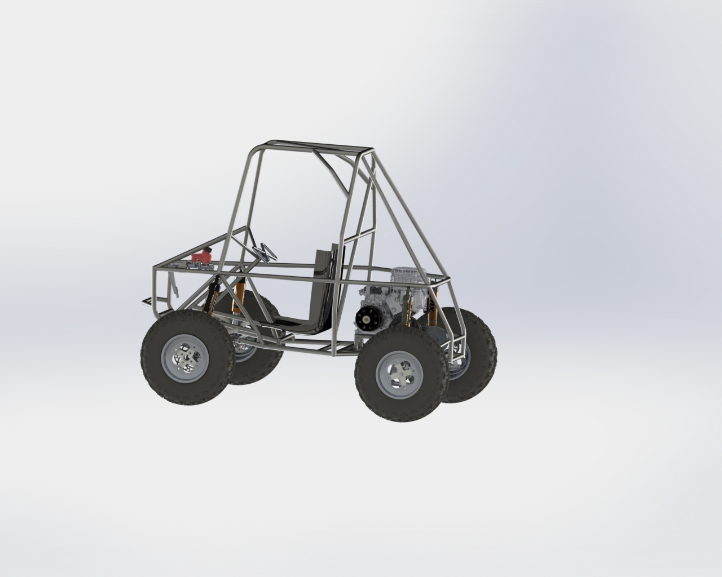
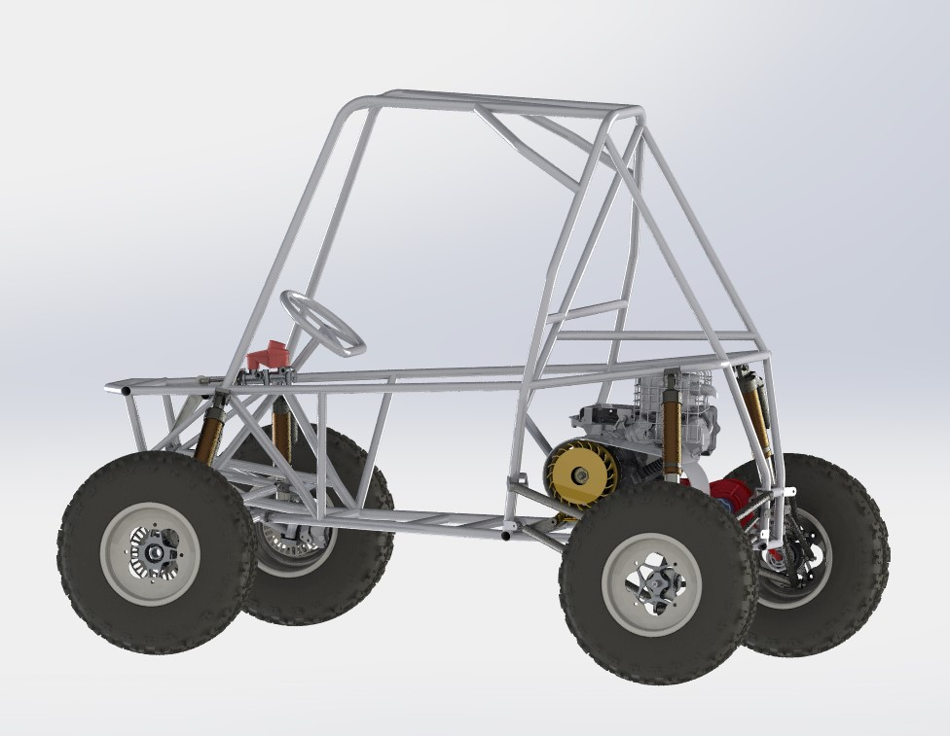
Comparison sheet
3
2020
2020 | 2021
2021
Wheelbase
1300 mm | 1400mm
Ground Clearance
13 in | 14 in
Tyres
Front – 22 X 7 X 10 inches
Rear – 22 X 7 X 10 inches
MAXIMUM SPEED
57.3 km/hr | 60 km/hr
Tripod integrated in gearbox
Active CVT Cooling
Passive rear steering
Integrated spindle in upright
Caster Offset Uprights (Vorlauf Geometry)
2 Part Serviceable Steering Casing
Floating rotor
MAXIMUM ACCELERATION
5.12 m/s² | 5.8 m/s²
1300mm | FRONT- 88.20 kg | Double A-Arm
Track width | WEIGHT (laden) | Suspension Type
1200mm | REAR-135.30 kg | Lower H-Arm & camber Link
TURNING RADIUS
1350 mm | FRONT- 84kg | Double A-Arm
Track Width | WEIGHT (laden) | Suspension Type
1280 mm | REAR-121 kg | Double A-Arm With toe link
2.1 meters | 1.8 meters
KERB WEIGHT
154 kg | 140 kg

Slide 7
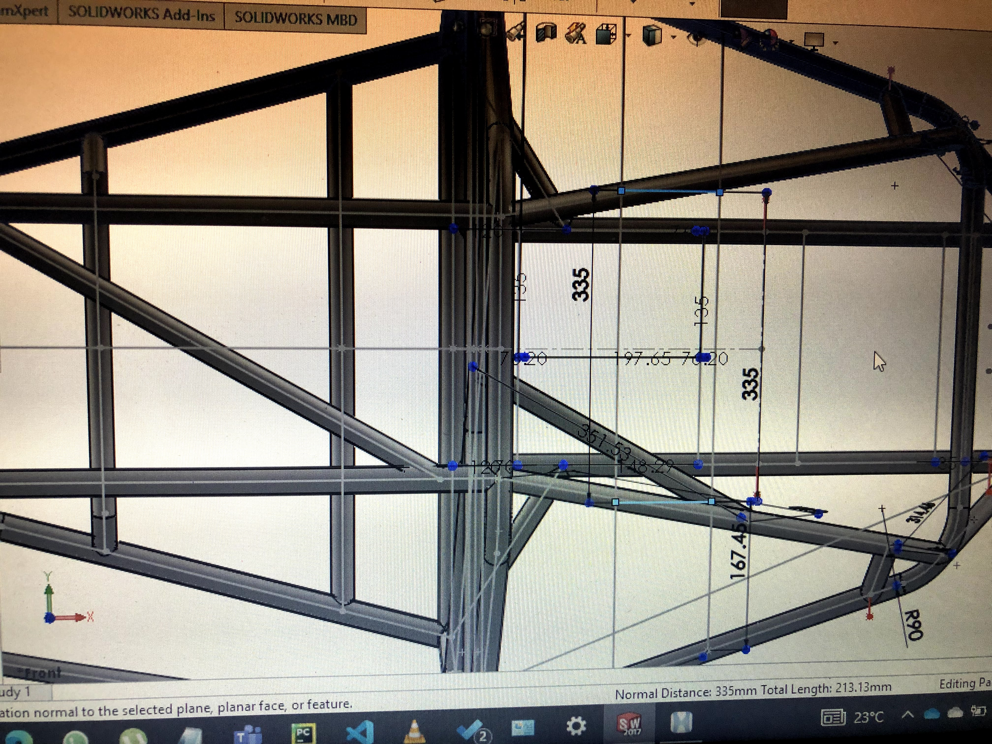
Images – CAD validation before manufacturing

Slide 8
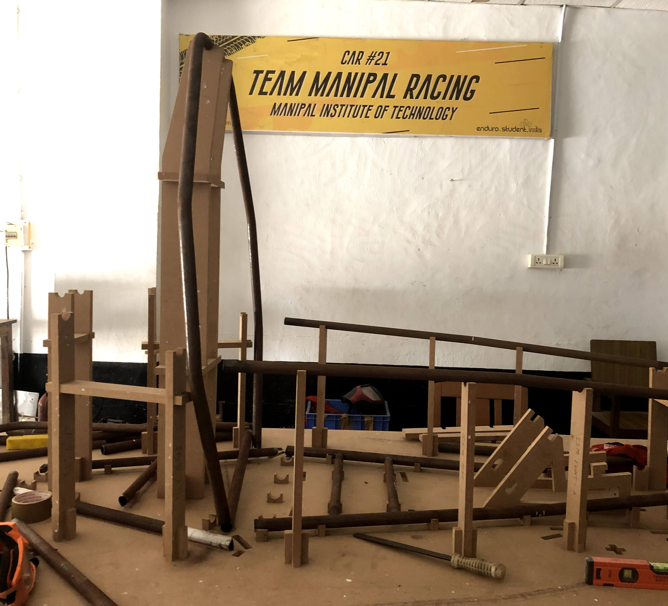
Images - Validation
Testing the jigs and fixtures for the chassis before welding

Slide 9
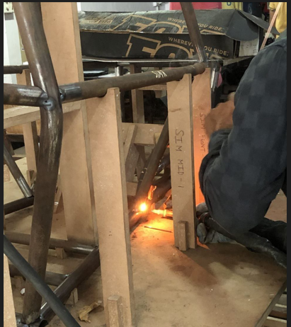
Images - Manufacturing
Using TIG welding to weld the frame together

Slide 10
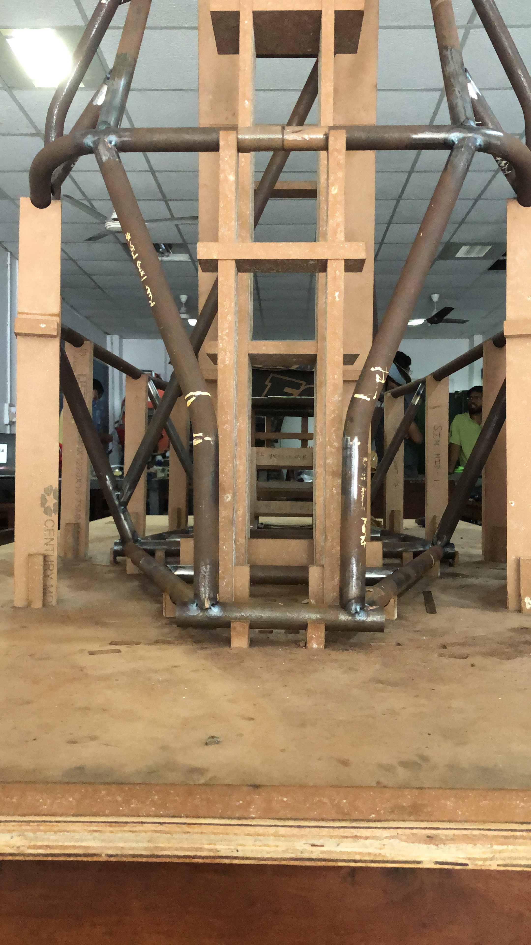
Images - Validation
Ensuring proper welding of the tubular members
We were looking specifically for blowout holes at the joints and in the members

Slide 11
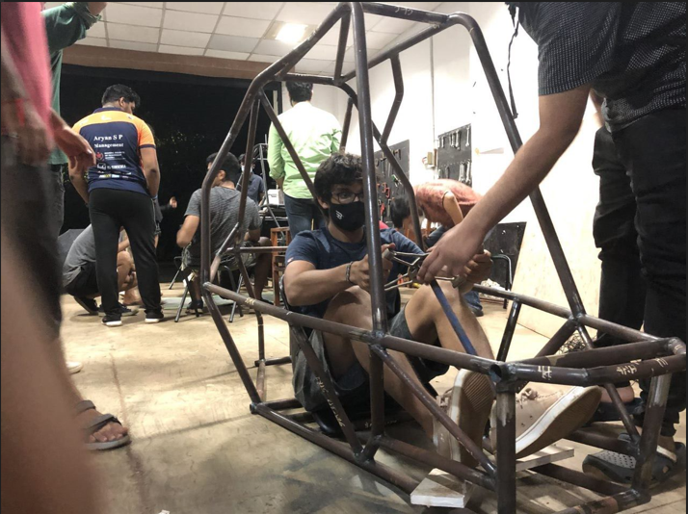
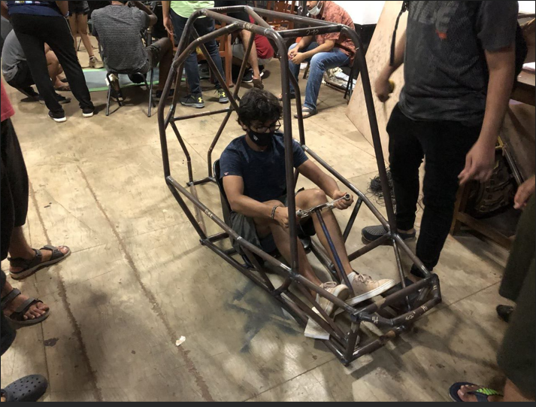
Images - Validation
Ergonomics validation after welding and weight testing

Slide 12
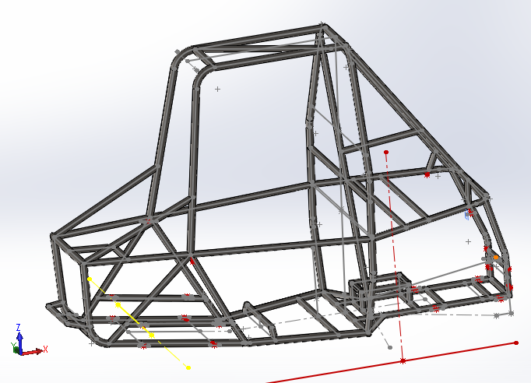
Images – Completed chassis

